Slide 1

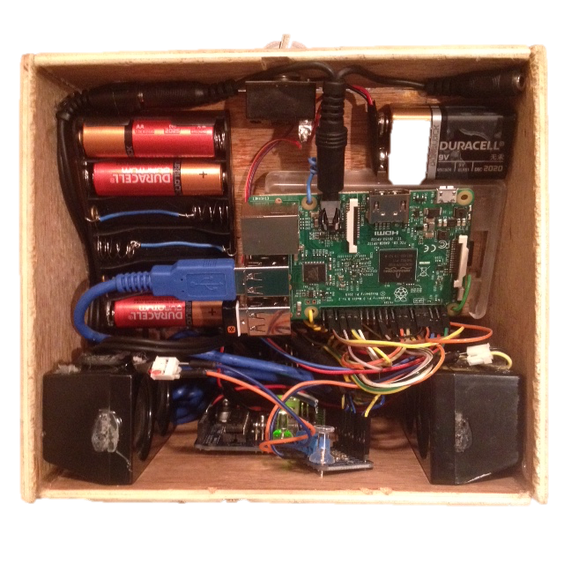
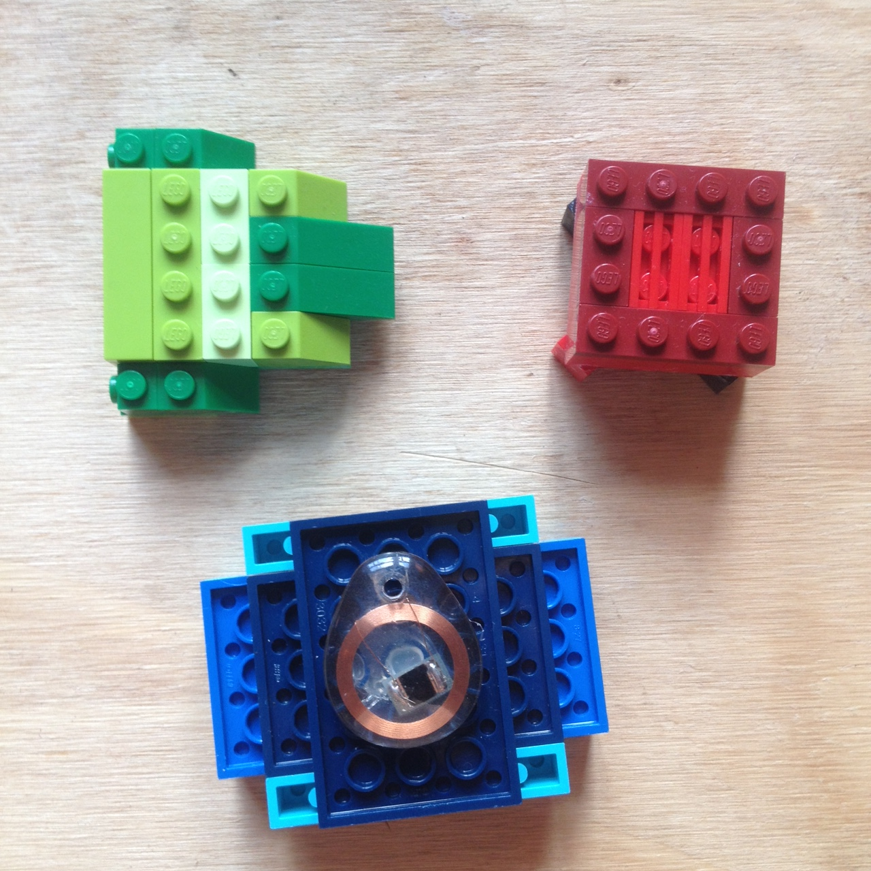
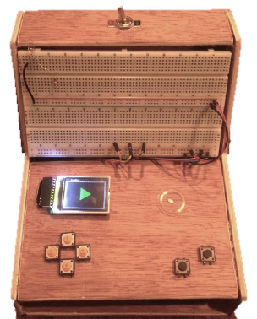
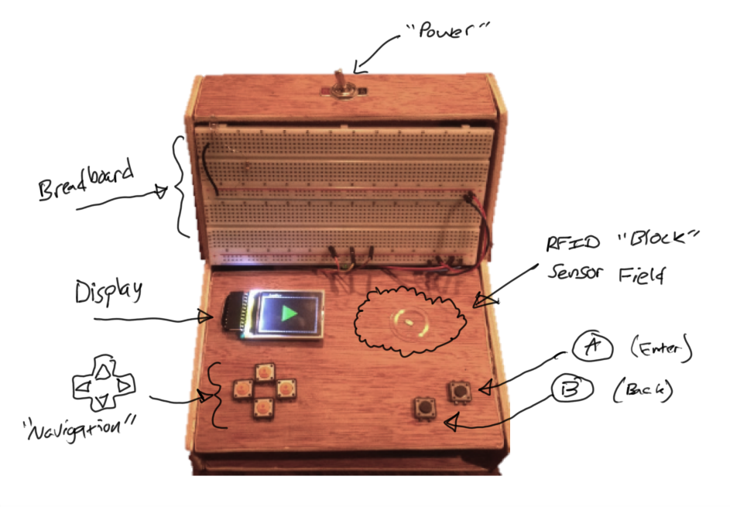
CodeBox64: A Tactile Input Modality for Block Programming SIGCSE 2017
Max Paulk
Amber Wagner
Computer Science Department
Kennesaw State University
ankwagner@gmail.com
Background
JamBlocks is a server application that uses Google’s Blockly API in addition to the ‘Vexflow’ library, allowing users to Compose Music in the form of “blocks”, as a Block-style Programming Language.
CodeBox64 is a custom-built “box” engineered to perform as a Tactile Input Modality (TIM) allowing Users to wirelessly & physically control the JamBlocks music engine.
Specs
How It Works
Comprised Of:
Raspberry Pi 3
Arduino Uno
PN532 (RFID)
1.8” Display
Speakers
Breadboard
Power
Wire/Cabling
Tactile Buttons
Uses:
PN532 Controller for interaction with ‘Blocks’
1.8” TFT Display for Visual Guidance.
Speakers for Audio.
Breadboard for Bread-boarding (experimenting).
RPi3 for wireless communication with JamBlocks Server.
Tactile Buttons:
Input
- A
- B
Navigation
- Up / Down
- Left / Right
Diagram
The user can use the arrow buttons to scroll through the blocks in the command palette
As the user “scrolls,” an audio sound is made to indicate the user has is on a block
The user can select a block, and it will be placed in the editor – also triggering an audio event
The physical lego blocks can be associated to block commands in the language and can be used in place of the arrow keys
)
)
)
)
Motivation
& Research Goals
To Teach & Encourage users to dabble in the interconnectedness of Music and the various STEM related fields of study it involves.
Block languages, such as JamBlocks, are not accessible to visually impaired users. CodeBox64 provides a custom, tactile interface to JamBlocks, thereby increasing access for visually impaired users.
Future Work
This is a simple prototype developed for a very simple block language, JamBlocks
The first step in future work is to improve the interface between CodeBox64 and any block language it controls
Fine tune audio cues
Apply to other block languages
Add Additional Hardware
3D-Print Final Build

